Slide 1
Materials Manufacturing (EDPT 601) Tutorial 1 Metal Casting By: Eng. Sherifa Taher

Slide 2
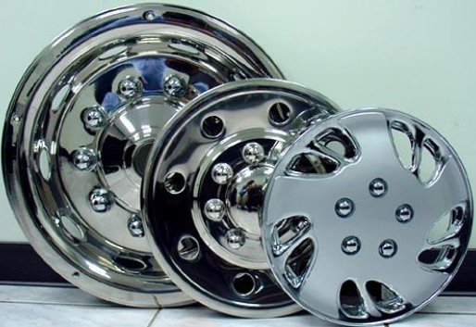
Metal casting
Casting is a process in which a liquid metal is somehow delivered into a mold that contains a hollow cavity of the intended shape. The metal and mold are then cooled, and the metal part (the casting) is extracted.
Casting is most often used for making complex shapes that would be difficult or uneconomical to make by other methods.

Slide 3
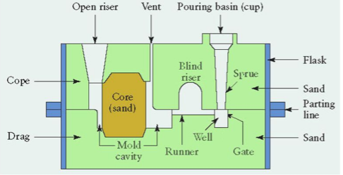
Sand Casting Process
Sand casting is an expandable (non reusable) metal casting process that uses sand as the mold material in addition to a suitable bonding agent that is usually “Clay”.
Molds made of sand are relatively cheap. This makes the process widely used that over 70% of all metal castings are produced via sand casting.
The features of a sand casting mold includes:

Slide 4
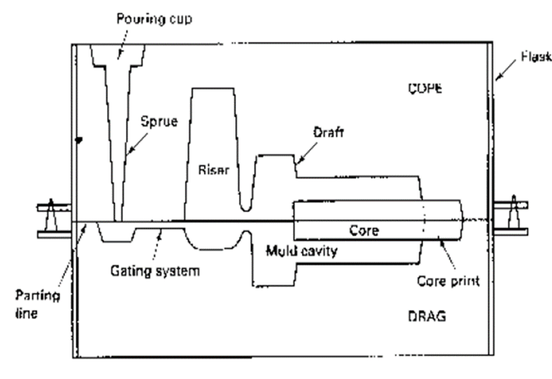
Features of sand mould
Pattern: approximate shape of the final casting.
Flask: the container that contains the upper and the lower halves of the mould.
Cope: Top half of the flask.
Drag: bottom half of the flask.
Core: sand shape that is inserted into the mould to produce internal features (holes).
Core print: region added to the pattern, core or mould that is used to locate and support the core within the mould.
Parting line: separates cope and drag.

Slide 5

Mould Cavity: Void to be filled with molten metal to produce the casting.
Riser: extra void in the mould (that will be filled with molten metal) and acts as a reservoir of molten metal to compensate for solidification shrinkage.
Gating system: channels used to deliver molten metal from outside the mould into the mould cavity.
Pouring cup: portion of gating system that receives the molten metal.
Sprue: vertical portion of gating system (metal flows from sprue to horizontal channels called runners and finally through controlled entrances called gates into mould cavity).

Slide 6
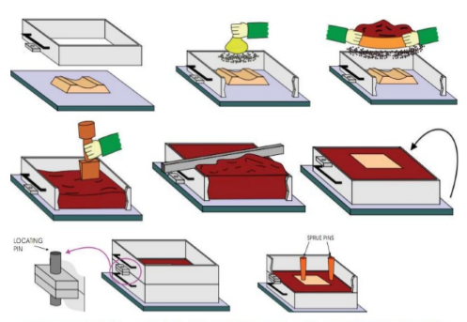
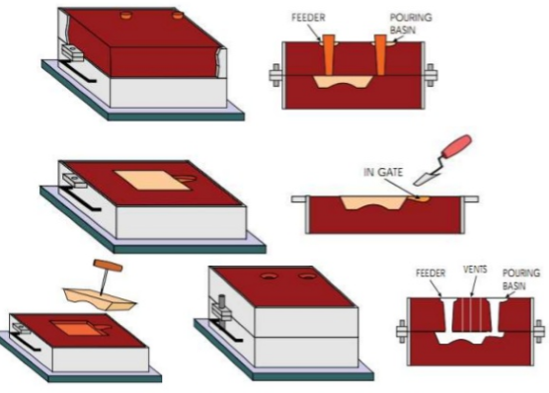
Sequence of steps for making sand mould

Slide 7
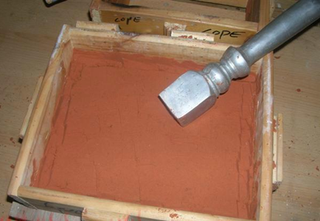
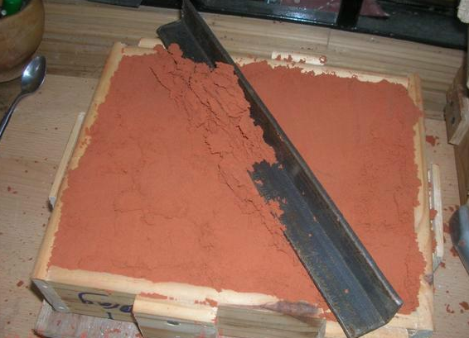
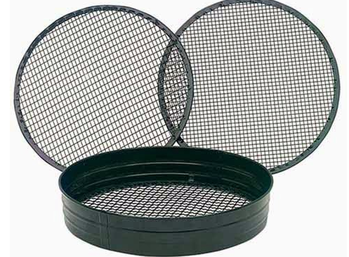
Tools used in sand mould preparation
Sand rammer: used to pack all the sand into the flask eliminating air pockets and loose sand that might ruin the final mould after pouring the molten metal.
Strike off bar: used to strike all the extra sand from the flask top or bottom.
Riddle: a screen or sieve used to remove small pieces of metal and foreign particles from the moulding sand.

Slide 8
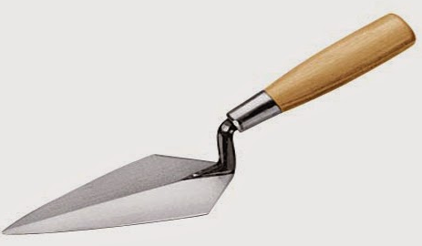
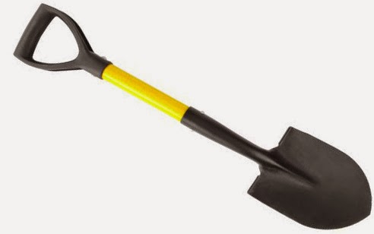
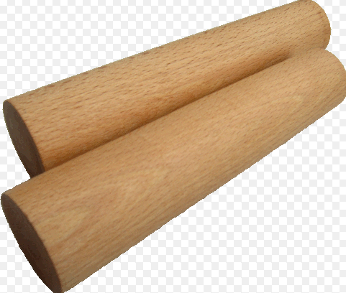
Trowel: is used to shape and smooth the surfaces of the mould and for doing small repairs.
Showel: is used for mixing and tempering moulding sand and for moving the sand pile to flask.
Sprue pin: A solid length of metal or wood used to form to the sprue for sand casting. Pin provides pathway for molten metal to pass into mould cavity.

Slide 9
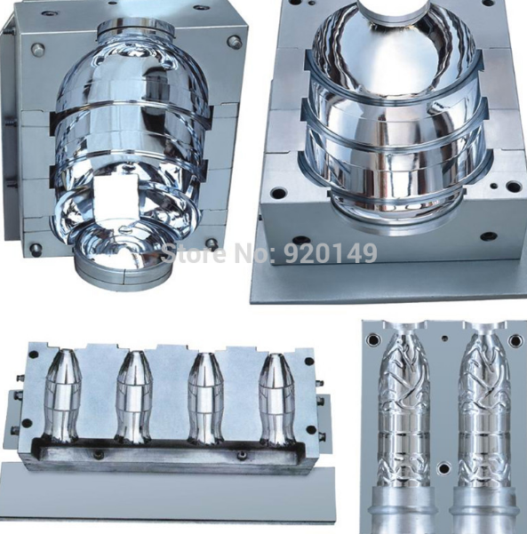
Metallic Mould Casting
Metallic mould casting is a permanent mold casting that uses a metal mold (die) that is typically made from steel or cast iron and can be reused for several thousand cycles.
Permanent mold casting is often referred to as gravity die casting as the molten metal is poured into the mould and not forcibly injected.
Typically used for high-volume production of small, simple metal parts with uniform wall thickness.

Slide 10
Steps for metallic mould casting
Mold preparation - First, the mold is pre-heated to around 300-500°F (150-260°C) to allow better metal flow and reduce defects. Then, a ceramic coating is applied to the mold cavity surfaces to facilitate part removal and increase the mold lifetime.
Mold assembly - The mold consists of at least two parts - the two mold halves and any cores used to form complex features. Such cores are typically made from iron or steel, but expendable sand cores are sometimes used. In this step, the cores are inserted and the mold halves are clamped together.
Pouring - The molten metal is poured at a slow rate from a ladle into the mold through a sprue at the top of the mold. The metal flows through a runner system and enters the mold cavity.
Cooling - The molten metal is allowed to cool and solidify in the mold.
Mold opening - After the metal has solidified, the two mold halves are opened and the casting is removed.
Trimming - During cooling, the metal in the runner system and sprue solidify attached to the casting. This excess material is now cut away.

Slide 11
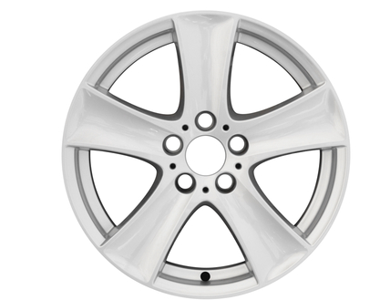
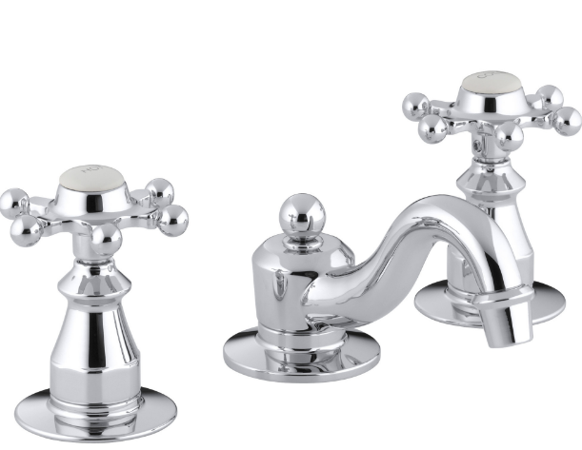
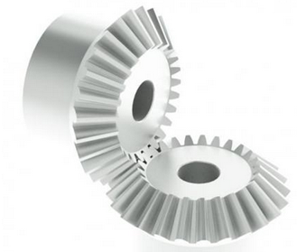
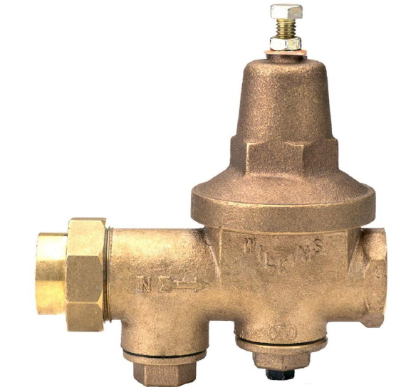
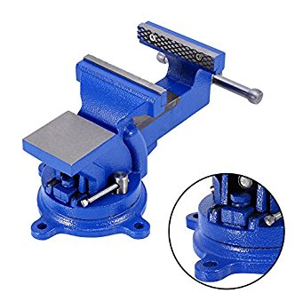
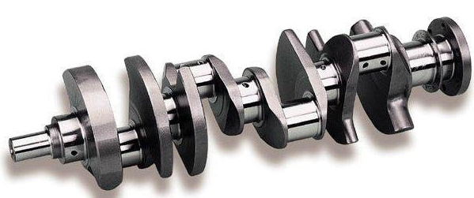
Cast products

